Slide 1
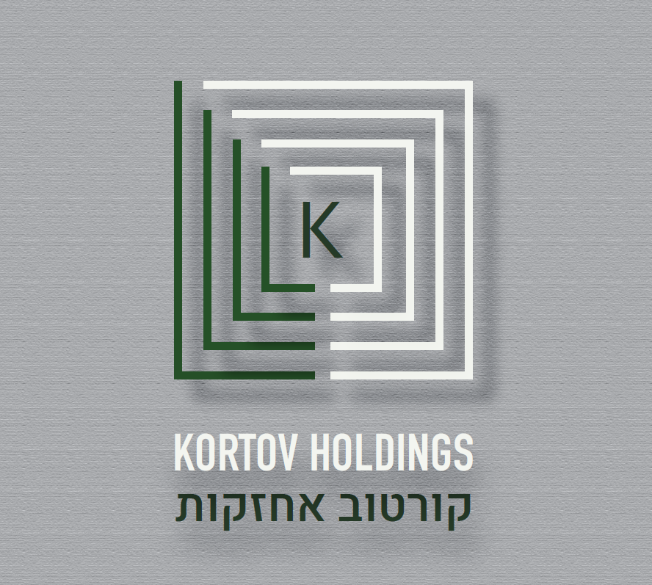

Slide 2
Operations are relocated to central Israel and the company’s name is changed to KMM
1989
2000
2003
TMM Integrated Recycling Industries was established in 1989, engaged in waste collection, recycling and disposal
1994
2001

Slide 3
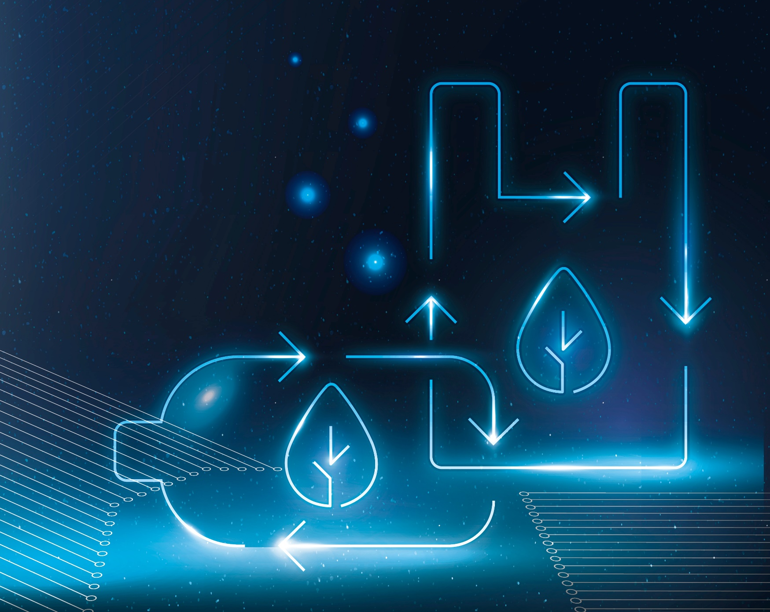
Y.R.A.V
The israeli largest waste collection company
Listed in the Israeli stock exchange
12 transfer station
1,000 workers
300 trucks
Sold to VIOLA in 2000 להוסיף לוגו של ויוליה

Slide 4
2014
Acquisition of the company "Tal-El"
2022
Collection
start for Cycle
2024
Establishment of
a packaging sorting plant with Tamir Corporation
Acquisition of 75%
of the company by
Logan
2015
2022
Signing of an agreement to establish a new packaging plant
Tamir Corporation

Slide 5









KMM Recycling Industries
THE ISRAELI LEADER IN
RECYCLING, WASTE TREATMENT
AND THE DEVELOPMENT OF
ENVIRONMENTAL PROJECTS
Cardboard
recycling
Tire
recycling
Textile
collection
Newspaper
recycling
Packaging waste
management for
TAMIR Recycling
Corporation
Waste treatment
transfer
stations
Paper recycling
and information
security services
Plastic
recycling
General
Paper
collection

Slide 6
KMM Recycling Industries
4 sorting plants
550 workers
150 trucks
Engaged with 90 municipal government's
Servising millions of people
Sold to Generation capital in 2022

Slide 7


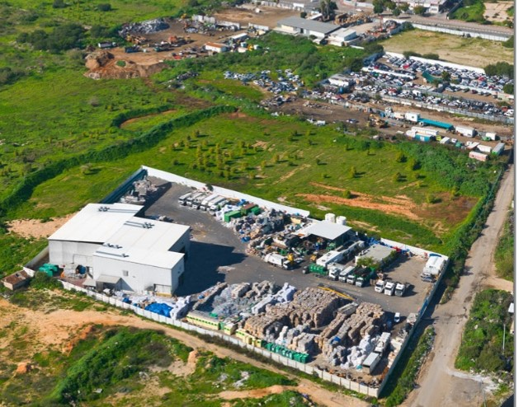
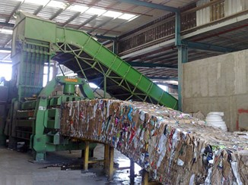

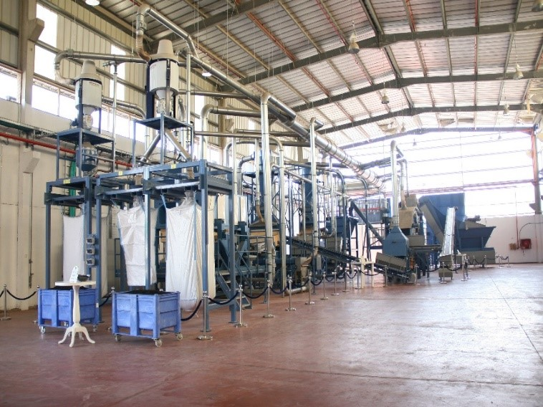



Main plant and company HQ
The company’s head office and main plant in the Rishon LeZion industrial park:
15,000 m², for the processing of paper, cardboard and plastic
T.M.Z. Tire
Recycling Ltd.
In the Emek Sara industrial park in Beersheba:
The T.M.Z. plant: 10,000 m², for the processing and recycling of tires
Tal-El
In the Nitzanei Oz industrial park:
15,000 m², for the processing of paper, cardboard and plastic

Slide 8
2014
Acquisition of the company "Tal-El"
2022
Collection
start for Cycle
2024
Establishment of
a packaging sorting plant with Tamir Corporation
Acquisition of 75%
of the company by
Logan
2015
2022
Signing of an agreement to establish a new packaging plant
Tamir Corporation

Slide 9
Cycle circular economy
The largest company in Israel to collect deposit bottles
Coca Cola is our partner
Collection from thousands points
Building 2 counting and sorting plants
100 workers
50 trucks
להוסיף לוגו סייקל

Slide 10
Competencies and Strengths
Countrywide deployment
End solutions
for a variety
of raw materials
Services
provided to
millions of citizens
Broad product
portfolio – all types
of dry waste
Decades of
personal
experience
Broad diversity of
customers in
different sectors
and across various
industries

Slide 11
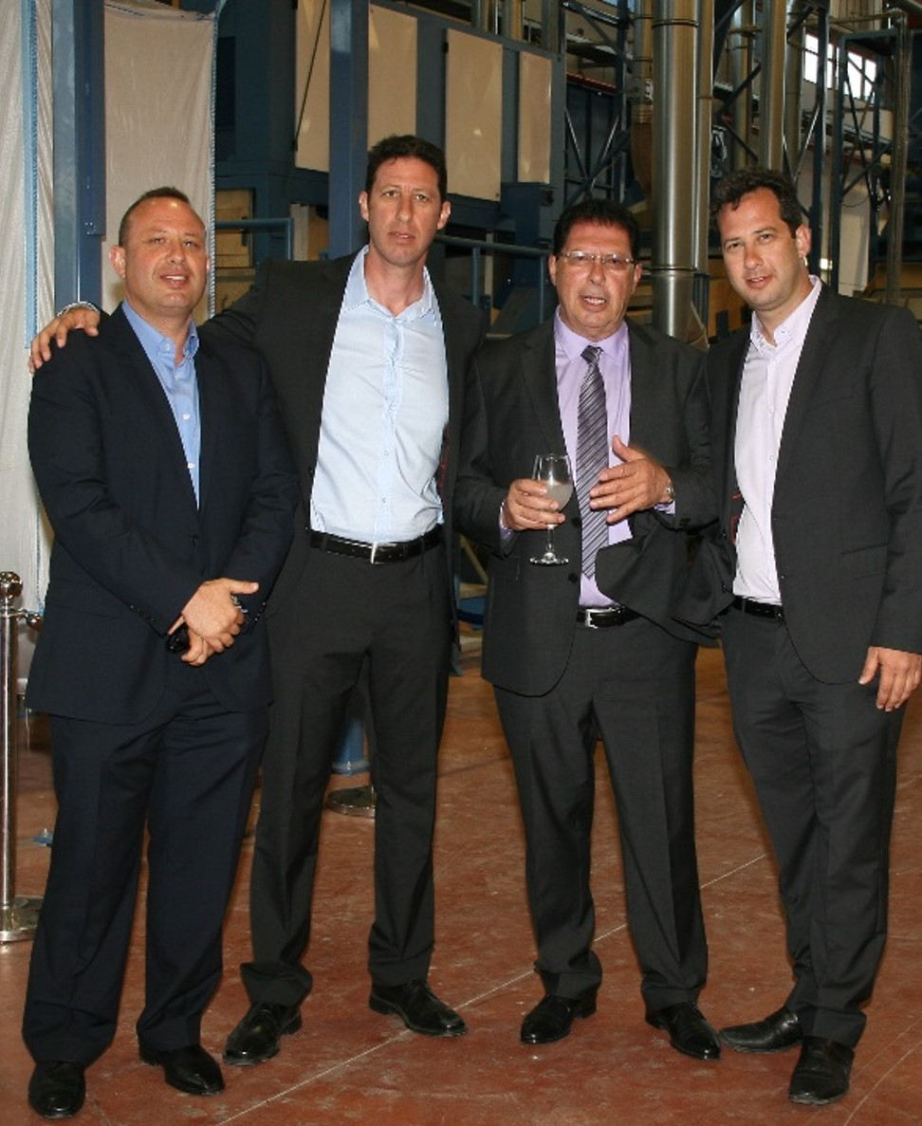
Executive Summary
The Kortov family – the driving force that leads the recycling industry in Israel
R & D of new collection and recycling methods
Continuous follow-up of global developments and changes in the recycling industry
Personal connections with numerous plants worldwide for the sale of raw materials to end users
הקמנו עשרות פרוייקטים חדשניים בנושא איכות הסביבה
העסקנו אלפי אנשים
קשר עם עשרות עריות ומועצות איזוריות

